Slide 1
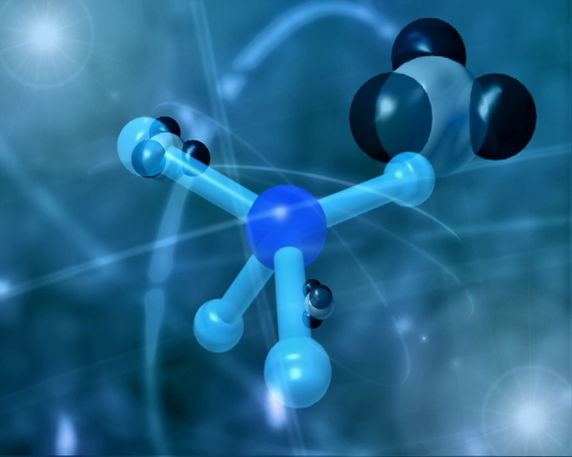
POLAR BONDS
‹#›
Notes:
‹#›
http://www.mhhe.com/physsci/chemistry/animations/chang_7e_esp/bom1s2_11.swf

Slide 2

Let’s Recap
When electrons are shared between two atoms – it’s a covalent bond.
In a molecule with identical atoms, the electrons are equally shared
Cl₂
Equal
Proton Pull
chlorine
chlorine
‹#›
Notes:
‹#›
Occurs when the atoms are do different that the electrons are NOT completely transferred like ionic bonds but are different enough to cause UNEQUAL sharing of electrons. Such bonds are known as POLAR COVALENT BONDS.
The bond is somewhere between an ionic and covalent bond!

Slide 3

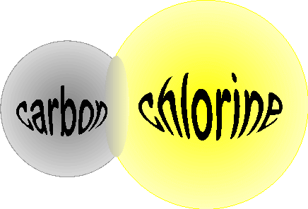
Polar Covalent Bonds
A bond that has an uneven distribution of charge due to an unequal sharing of bonding electrons. E.g. HCl
+
-
Hydrogen
‹#›
Notes:
‹#›
BECAUSE the bonding electrons spend more time new one atom that near the other.
In other words, chlorine has the power to attract or pull the electrons closer to it because it has a higher proton pull! Remember the tug of war exercise!
As a result, hydrogen atom is slightly positive charged while the chlorine atom is slightly negatively charged.

Slide 4
Polar Covalent Bonds
Use delta (δ) to indicate “a small difference” in charge
Cl has a strong attraction to the shared electrons, thus creating a partial negative “pole”
δ⁺
δ⁻
Positive Pole
H Cl
Polar covalent bond contain a dipole (one end is positive and other is negative)
X^{δ+}
Y^{δ-}
Positive End
Electrons pulling this way
‹#›
Notes:
‹#›
We can predict which part of the molecule will have δ positive or δ negative charge by comparing the electronegative of the atoms.
Electronegativity – ability of an atom, when bonded, to attract electrons.
The most electronegative atoms will attract electron pair strongly, and so will tend to have a negative pole in the covalent compounds they form.
When two different atoms are bonded covalently, the shared electrons are attracted to the more electronegative atom of the bond, resulting in a shift of electron density toward the more electronegative atom. Such a covalent bond is polar, and will have a dipole (one end is positive and the other end negative).

Slide 5
Electronegativity
Electronegativity INCREASES
H 2.1 |  |  |  |  |  |  | He
Li 1.0 | Be 1.5 | B 2.0 | C 2.5 | N 3.0 | O 3.5 | F 4.0 | Ne
Na 0.9 | Mg 1.2 | Al 1.5 | Si 1.8 | P 2.1 | S 2.5 | Cl 3.0 | Ar
Electronegativity DECREASES
‹#›
Notes:
‹#›
Remember!

Slide 6
Bonding Continuum
Helps us to understand the type of bonding that occurs between two atoms
1.7
EN Diff ≥ 1.7 = Ionic
EN Diff <1.7 = Covalent
0 = pure covalent
Ionic bond
0.4-1.699 Polar Covalent
1.7
0.4
0
3.3
0 - 0.400
non-polar covalent
See pg 84
Electronegativity Difference
‹#›

Slide 7
Now you try some!
Pair of Atoms | EN Calculation | Type of Bond
H-Cl | 3.0-2.1=0.9 | Polar Covalent
H-H | 2.1 – 2.1 = 0 | Pure Covalent
S-H | 2.5-2.1 = 0.4 | Polar Covalent
O-H | 3.5 – 2.1 = 1.4 | Polar Covalent
F-H | 4.0 – 2.1 = 1.9 | Ionic
‹#›

Slide 8
Polar Molecules
Presence of polar bonds within a molecule can affect the polarity of the entire molecule.
For a molecule to be polar it must meet two requirements:
Contains a polar bond
Molecule does not have symmetry either
Up
OR side ways
Down
‹#›

Slide 9



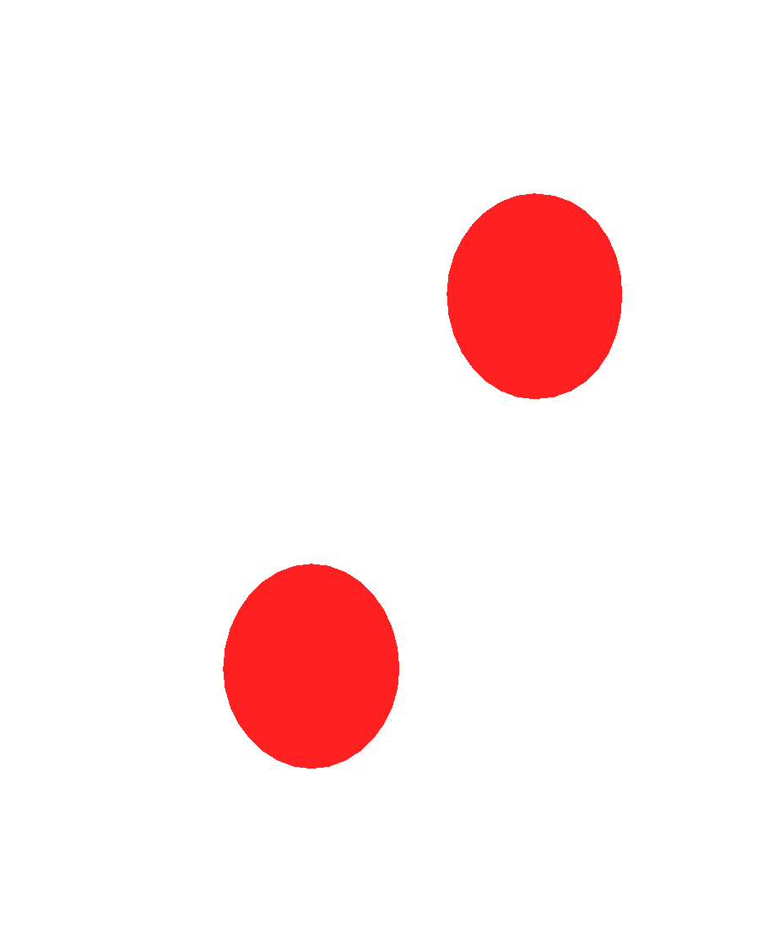
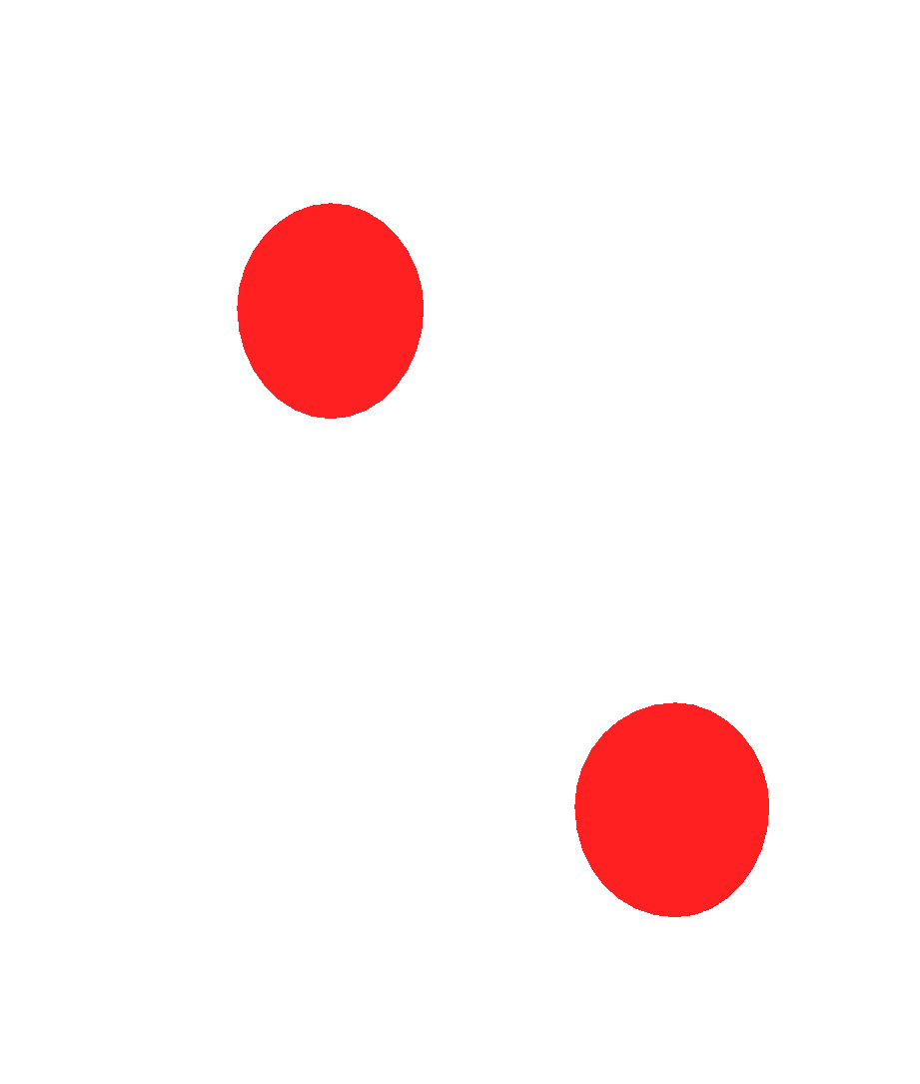
Is Water a Polar Molecules ?
Water : H₂O (2 + 6 = 8 e⁻)
EN Difference = 3.5-2.1 = 1.4
Polar Bond
2.1
3.5
2.1
H O H
If water is drawn like this, it would be a non-polar molecule.
δ⁺
δ⁻
δ⁺
It has a symmetry so the 2 dipoles cancel each other out.
Structural diagram shows us the real shape:
δ⁻
O
H H
Molecule is asymmetrical top to bottom. It has a negative and a positive end ∴ polar molecule
δ⁺
δ⁺
‹#›

Slide 10
Non-Polar Molecules
It is possible for a molecule to contain polar bonds but be a non-polar molecule
Any polar bonds?
EN Difference of C and Cl = 0.5
Yes, 4 Polar Covalent
δ⁻
Cl
δ⁺
δ⁻
Cl
C
Cl
δ⁻
Is it asymmetrical?
X No
CCl₄ is symmetrical, it lacks oppositely charged ends
Cl
δ⁻
negative
negative
‹#›

Slide 11
Non-Polar Molecules
δ⁺
δ⁺
Ex. PBr₃
δ⁻
δ⁻
P
Br Br
Br P Br
Br
δ⁻
δ⁻
δ⁻
Br
δ⁻
Contain polar bond
Asymmetrical
∴ Polar molecule
δ⁺
Ex. HCN
H – C N
δ⁻
Both dipoles have negative end on one side, therefore polar molecule even though it is linear.
‹#›

